Slide 1
Water Fund, Climate Change, and Negative Externalities
Science, Policy, Attitudes, Student Discussion

Slide 2
Schedule and due dates
Quiz 2 due today
Writing Assignment Due May 9th at 2pm (make sure to use the rubric!)
In class meeting May 9th guest lecture by Michelle Bennett
Extra credit due May 9th
Exam II May 16th during class time – this is the final exam
No final exam

Slide 3
Sections of the paper
Each section is approximately one paragraph.
Sections of the paper should look like this:
Problem statement /intro
Environmental Aspects
Economic Aspects
Social Aspects
Institutional Aspects
Solution description (it is ok to have no citations in this section if it is a new idea)
References/Works Cited

Slide 4
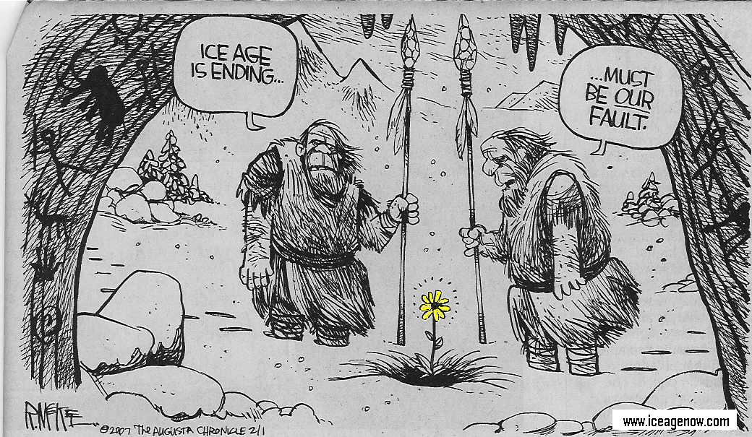
We are in an “inter-glacial”

Slide 5
Negative externalities
External costs occur when a decision maker chooses a level of production or consumption and does not fully bear the costs of his or her actions
Party A makes a decision, which harms Party B, with no compensation and Party B had no say
Frequently happens in natural resource setting—less so in other situations

Slide 6
Remedies
“An ounce of prevention is worth a pound of cure.”
~Benjamin Franklin
Compensate those harmed directly
Property rights assumption (Coase Theorem)
Lawsuits
Pollution Standards (Command-and-Control)
Tax Pollution
Examples (Solid waste pay-per-throw policy, turtle harvest tax, water pollution taxes, development impact fees)
Challenge - finding appropriate tax rates
Green labeling

Slide 7
Brandywine Christina Healthy Water Fund
Draft Business Plan
Presented to
Stakeholders
May 4, 2017

Slide 8
Goal
To create self-sustaining conservation finance vehicle that will restore the Brandywine-Christina watershed to fishable, swimmable, potable status in an accelerated timeframe.

Slide 9
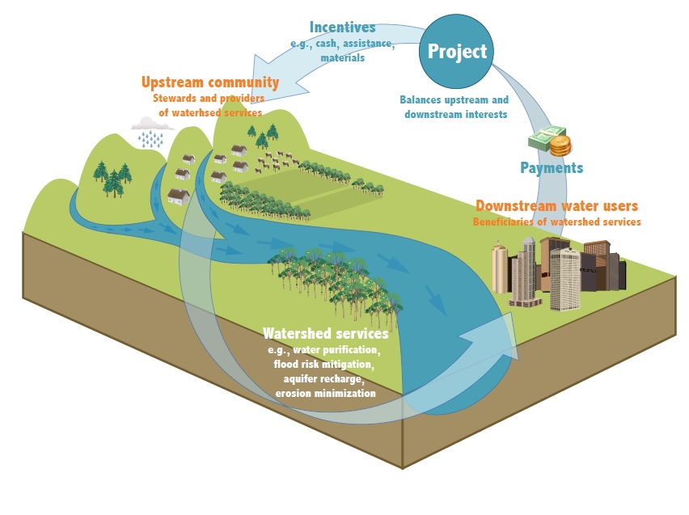
Water Fund Model

Slide 10
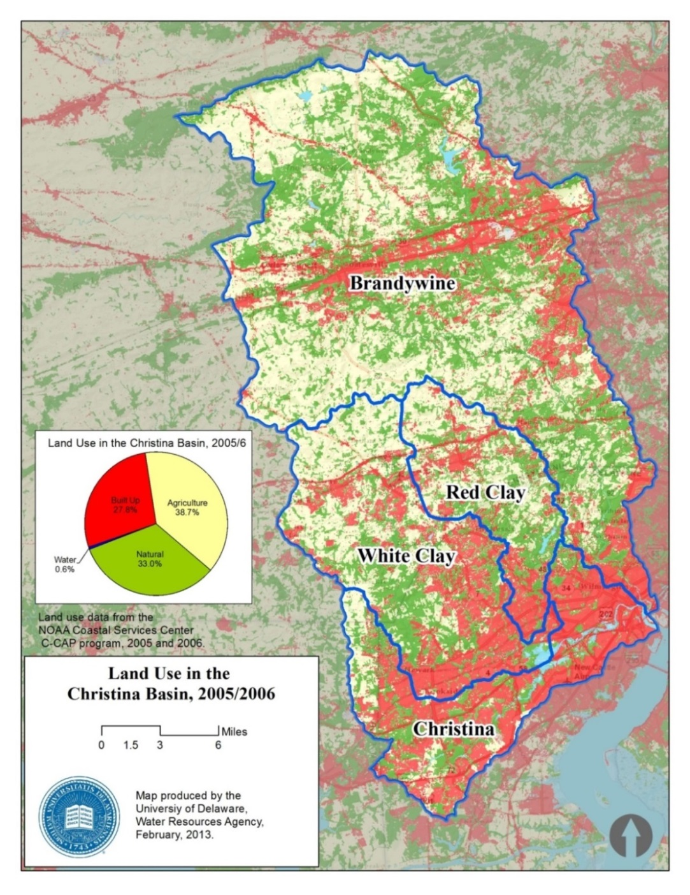
The Brandywine Christina
Two states (DE & PA) – evenly split amongst agriculture, urban and natural lands
Highly productive small farms in major-metro food-shed
Drinking water for 600,000 people – Six surface withdrawals
Majority of watershed “impaired” under CWA: TMDL and MS4s
Farms yield significant sediment and nutrient reductions
Meeting the TMDLs in PA and DE will require millions of dollars in investment

Slide 11
Basic business strategy
Water Companies
Municipalities
Foundation/Corporate
Align and Expand Capital
GIS-Based Targeting
Leveraging Relationships
Quantifying Impact
Strategic Capital Deployment
Long-Term
Freshwater Security
Sustainable Funding
Enduring Practices
Profitable Farming

Slide 12
How will the Water Fund work?
Provides a mechanism to value a pound of pollution reduction
Demand – beneficiary need projections
Supply - services and accounting
Brief overview of sections in plan:
Proposed governance structure
Financial projections
Notes:
By the end of this presentation you should understand the answers to these questions.
The business plan has been built through developing an understanding of the state of conservation outcomes implementation, reporting, and accounting in the B-C watershed. Its focus is to provide services that are not currently offered in the watershed that will significantly advance conservation implementation and funding for water quality improvements. The focus of the business plan has been:
developing potential customer profiles and needs;
determining what services the Fund will offer and at what price;
how to build a revenue stream for operational stability;
lastly, maintaining and understanding that how the Fund is built in initial phases sets it up for larger conservation and impact investing in the future (year 5 and beyond).

Slide 13
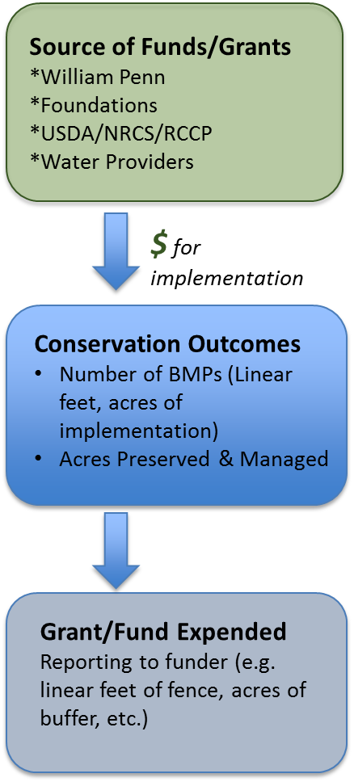
Current project path
Importantly, the funds are expended and investment is not fully realized. How do we monetize the conservation outcomes to generate more investment in restoration?
Notes:
Why is the Fund is new and different than what is currently provided?
Here is a general path of current funding for restoration projects.
Grant funds go to direct project implementation and staff time to implement projects.
Projects are implemented and the project is complete.
There is leveraging of grant money (in-kind etc) however the Fund will leverage this money to receive additional money through providing additional services.

Slide 14
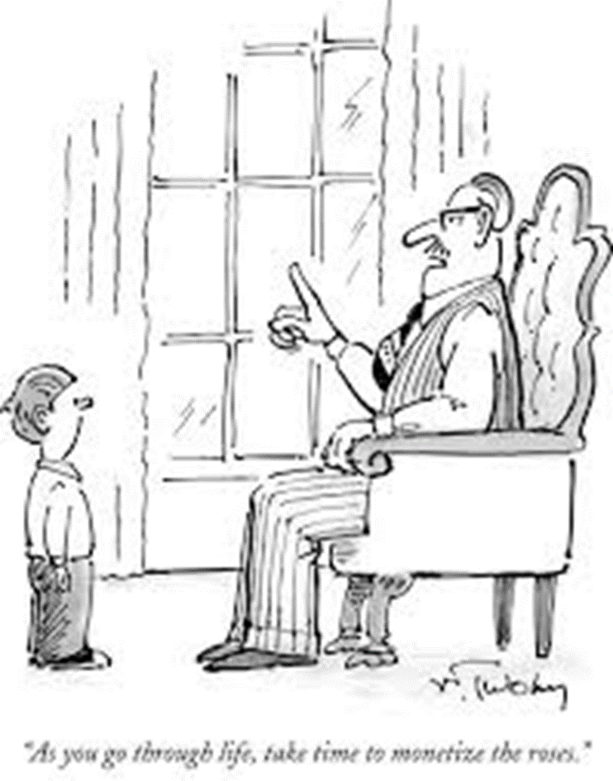
“As you go through life, take time to monetize the roses.”

Slide 15
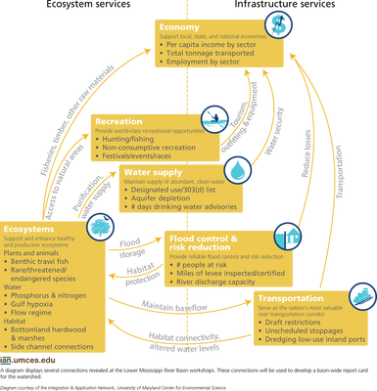

Slide 16
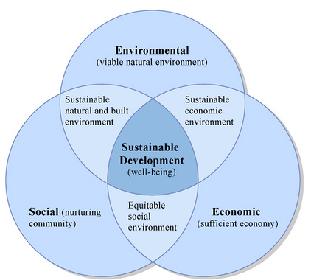
Sustainable systems
Current outcomes
Water Fund
will tie in
the economic and social outcomes to beneficiaries of conservation practices

Slide 17
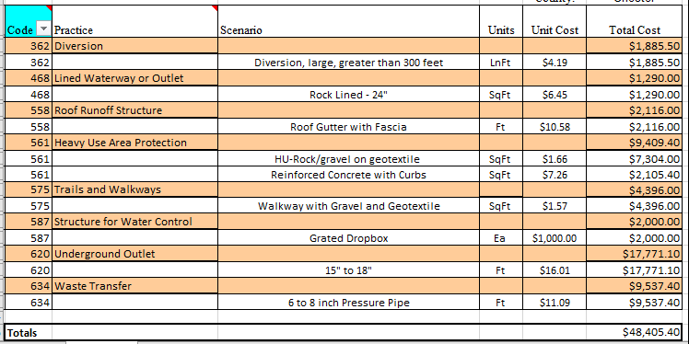
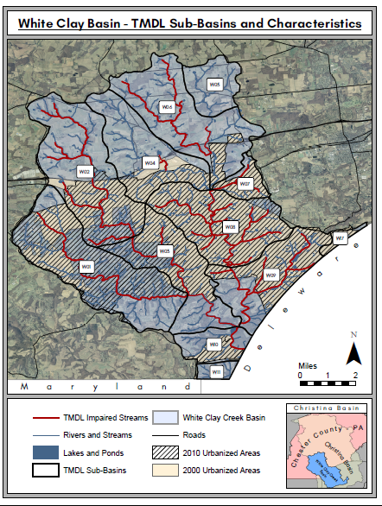

How does the Fund work?
POUNDS
POSITION
PRICE
Notes:
The Fund will work by tracking the amount of sediment (and in the future nutrients and quantity) in pounds within strategic areas (position) of the watersheds that benefit customers. The tracking and accounting will be part of a contract at a set price for the customers.
This work is currently not done in the watershed, will require substantial time and effort, but will provide the pathway for additional investment in conservation projects that benefit water quality.
The total value of the work being performed in the watershed will be within the pound that is sold. Current projects implemented are missing the link that will provide future watershed investment. This is where the Fund provides new services to enhance and grow our partners work in improving water quality.

Slide 18

Water Fund services
Demand
estimation & pricing
of services
Project coordination,
accounting and
reporting
Reinvestment
of funds

Slide 19
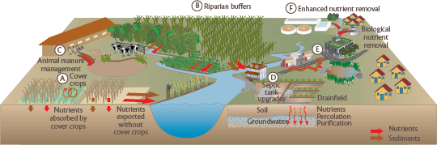
What is the value of a pound?
http://ian.umces.edu/blog/2010/03/04/hello-my-name-is-chesapeake-bay-and-i-have-a-nutrient-problem/
The value of a pound of sediment removal from the watershed can be determined through what beneficiaries’ needs are for that pound of reduction and how much it costs to provide that reduction.
Notes:
We know there are multiple benefits to implementing farm BMPS but how does the Water Fund proposed to value the off farm benefits?
Two sets of beneficiaries
Different and overlapping needs
How does the Fund provide services for these beneficiaries
Provide verified, maintained, and cost-effective sediment reductions that meet the specific needs of customers:
1) MS4/NPDES: permit obligations
2) Water providers: operating costs reductions and risk mitigation

Slide 20
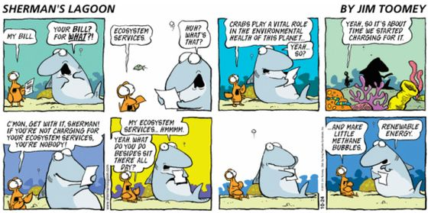
Value and services

Slide 21
Needs of primary beneficiaries
Beneficiaries: MS4s and Water providers
Needs: Sediment and nutrient removal
Pollution removal prices based on potential demand from these two beneficiaries.
Notes:
The current project implementation documents what the grant providers require to fulfill the grant.
The Fund proposes to begin tracking projects in a new way, a way that aligns the projects to fulfill external needs of the watershed and water users.
Recognizing that the projects project water quality benefits is nothing new. However monitoring and accounting of the project outcomes in a manner that can enable sediment (nutrient and quantity) reductions is not currently performed.
The Fund initially will set up the mechanisms to account for removal of sediment. The work that needs to occur for this to happen is substantial. Dedicated staff will coordinate projects that are in the interest of potential customers and negotiate the outcomes with regulators.
There are two customer groups the Fund will target MS4 communities and water service providers.

Slide 22
Projected demand (5yr)
Beneficiaries | Target Pollutant | Quantity Demanded
MS4* (PA & DE) | TSS | Approximately 30 +/- tons/yr.
Water** Providers (Private & Public) | TSS | Approximately 25+/- tons/yr.
*Demand will be further understood within the first year of the funds function as the MS4 communities determine their projects for reductions.
**Proxy for water provider is based on current willingness to invest
Notes:
Estimation of demand very conservative at this time involves anticipating 2 things
Regulator agreement (permit incorporation) – The MS4 estimations are lower and upper bound. The
Customer willingness to pay (price, impact on operations, rate recovery)
The 2 customer groups and their estimated demand is based on conservative projections to build a steady supply of sediment reductions. (10% permit requirements for a subset of PA muis, DE and water providers willingness to pay)
The supply must not exceed demand or the fund will be bankrupt (there will be too much sediment and no buyers).

Slide 23
Pricing TSS service on MS4 sample urban abatement curve
*This is stylized. Fortunately, the Fund will know this abatement curve for each MS4 based on permits submitted.
Water Fund
supplies the
“last 20-25%”
at cost below
MS4’s average
cost.
Ave. cost of TSS removal: ~$13lb
Notes:
The price of a pound of sediment has been estimated in multiple written documents for municipalities to agricultural BMP implementation documents. The municipalities and water providers complete and install removal technologies at the low cost end of the curve. The Water Fund services need to be priced to be below what the higher cost technologies are.
However, the important aspects of price for a pound of sediment for the Fund are how low can we price and how low should we price a pound.
We could place the price of a pound for immediate sustainability, but that would be likely too high and unrealistic. We need to understand our customers needs.
In understanding one customer’s needs (MS4) price estimates should be below what they will face to do the projects to reduce sediment on their own.

Slide 24
Water service providers
Based on what currently paying
Value will be determined by what the public service commission and or city council is willing to approve
The Fund provides a vehicle to value the pollution removal in a manner that can be adopted by the oversight bodies

Slide 25
Projected demand and price (5yr)
Beneficiaries | Target Pollutant | Quantity Demanded | Price
MS4 (PA & DE) | TSS | Approximately 30 +/- tons/yr. | $4-$6/lb
Water Providers (Private & Public) | TSS | Approximately 25+/- tons/yr.
Notes:
Estimation of demand very conservative at this time involves anticipating 2 things
Regulator agreement (permit incorporation) – The MS4 estimations are lower and upper bound. The
Customer willingness to pay (price, impact on operations, rate recovery)
The 2 customer groups and their estimated demand is based on conservative projections to build a steady supply of sediment reductions. (10% permit requirements for a subset of PA muis, DE and water providers willingness to pay)
The supply must not exceed demand or the fund will be bankrupt (there will be too much sediment and no buyers).

Slide 26
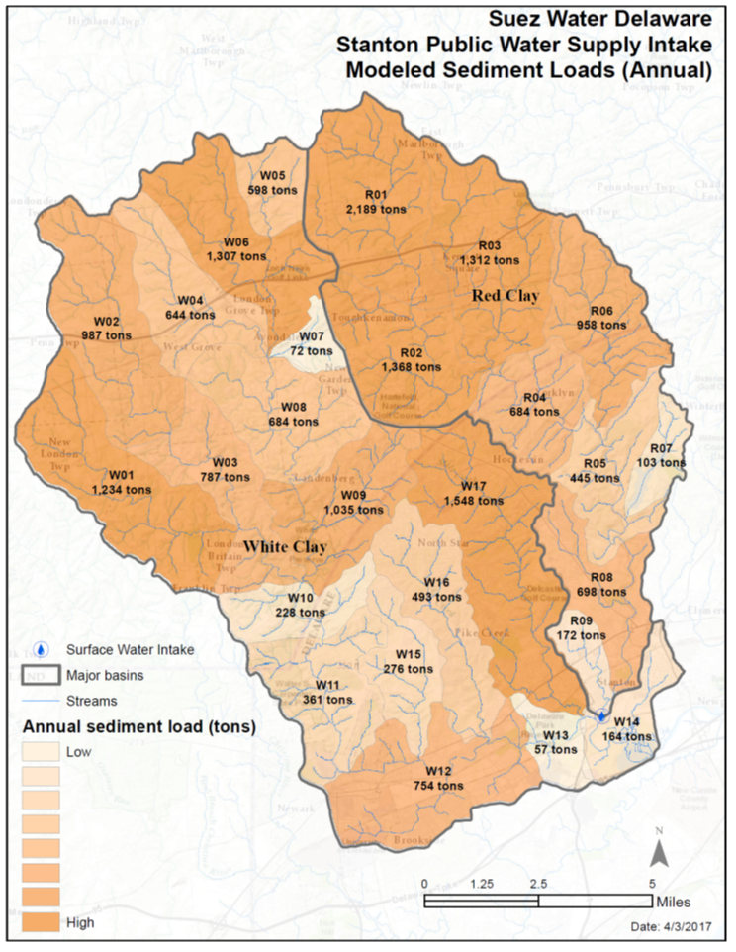
Agricultural BMPs

Slide 27
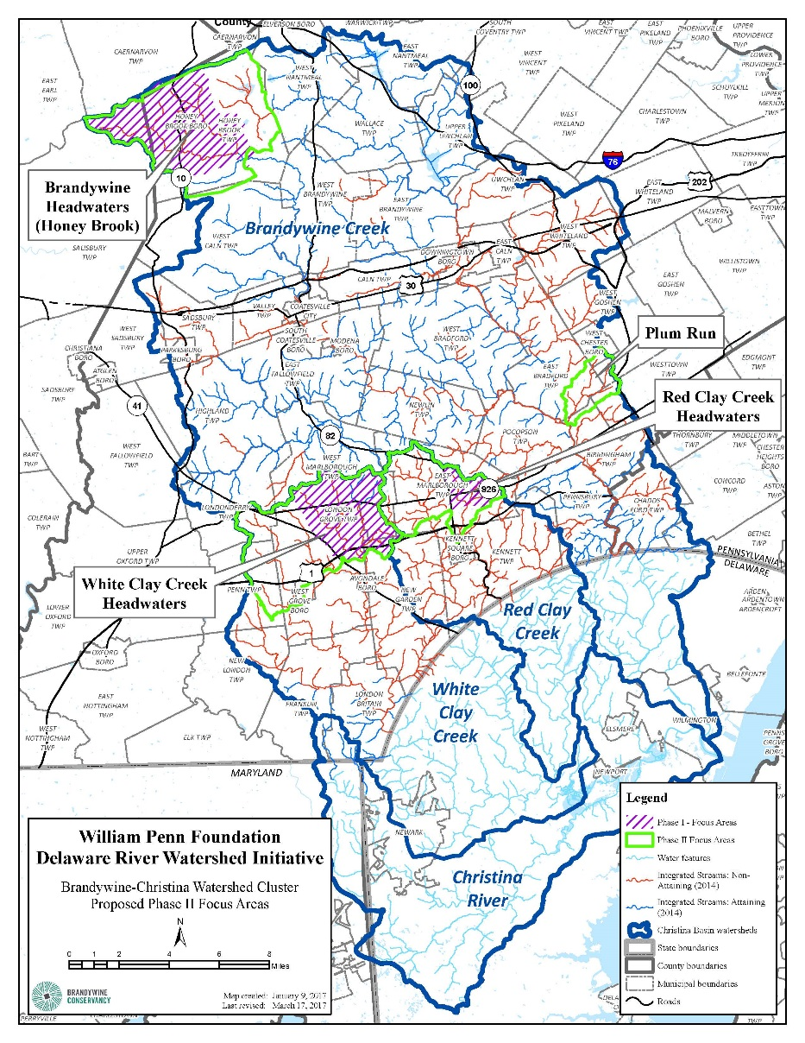
Project coordination
Notes:
Project coordination with partners is important as well. Leveraging on farm relationships and conservation plans that partners work toward implementing.

Slide 28
Leveraging existing watershed funding
Barrier to farm restoration, ~30% funding shortfall
Over time –philanthropic is replaced with market based funds. Each $1 leverages $2.33 of current funds
Notes:
The Fund will work by leveraging cluster partner actions currently employed.
There is a barrier to implementation where approximately 30% of the money from implementation is not covered.
% refers to amount of total project funding from all sources
Graph on left indicates 30% shortfall
Graph on right indicates fund provides that 30% to cover the gap and allow all restoration work to proceed… so that every $ invested by the Fund takes advantage of $2.33 of other funding to deliver its sediment reductions
The initial plan is for the shortfall to be provided by the Fund through philanthropic capital.
This capital will be used to build a supply and provide services to customers.
That work by the Fund will then enable sales of these services to customer groups.

Slide 29
Projected service provision
Service | YEAR
 | 1 | 2 | 3 | 4 | 5 | 6
# of Farms | 1 | 3 | 10 | 12 | 2 | 2
Cum. # of Farms | 1 | 4 | 14 | 26 | 28 | 30
TSS inventory (TN/YR) | 2 | 9 | 32 | 60 | 65 | 69
TSS demanded (TN/YR) | 0 | 0 | 0 | 54 | 54 | 67
Net TSS | 2 | 9 | 32 | 6 | 11 | 2
Notes:
Multiple projections and scenarios for financial performance indicated that with these estimates and at a price of $4-$6/lb the Fund will achieve sustainability in year 6.
The tacking, validation, and reporting of reductions will be coordinated with customers, regulators, and the governing board. Validation of the generated reductions will be via PADEP and later DNREC as project outcomes necessitate.
The net TSS will be reserved as insurance (e.g. BMP failures). With these projections at least 10% of demand will be reserved.
So why cant anyone do this? Good question. The current organizations in the watershed do an amazing job of implementing the activities to support farms and watershed. However, capacity to do “extra work” required for this effort does not exist. Substantial work has been done to develop this business plan and tailor it to the unique watershed needs. Staff of the Fund will have the explicit duties to coordinate and consolidate effort with the sole focus of bringing in additional investment.
The financial projections for this business plan incorporate the fact that dedicated staff are a necessity to provide the project selection tailored to customers, tracking, reporting, negotiation, and contract writing.

Slide 30
Long term projections

Slide 31
Financial projections
Notes:
Private and public grants impact investments
Revenue in years 4+

Slide 32
Operations
An independent business organization.
Facilitate projects and accelerate scale of implementation that would not have occurred without the activities of the Water Fund.
Dedicated staff to facilitate partner projects and cultivate sustainable funding streams.
Governing body to provide guidance and expertise in aligning restoration with beneficiaries.
Notes:
At the end

Slide 33
Challenges
The Water Fund faces three challenges to effective and successful implementation:
Sufficient capitalization to adequately resource activities and staff.
Providing recognized, streamlined, and efficient process to partners.
Navigating regulatory uncertainties to generate sustained revenue.

Slide 34
Remedies: Which of these is the Water Fund?
Compensate those harmed directly
Property rights assumption (Coase Theorem)
Lawsuits
Pollution Standards (Command-and-Control)
Tax Pollution
Examples (Solid waste pay-per-throw policy, turtle harvest tax, water pollution taxes, development impact fees)
Challenge - finding appropriate tax rates
Green labeling

Slide 35
DISCUSSION
How does the Water Fund “remedy” negative externalities?
The Water Fund puts a price on a pound of pollution
Sets up a “market” for the pollution reduction

Slide 36
What is wrong with this statement?
“DO YOU BELIEVE IN CLIMATE CHANGE?”

Slide 37
Climate Change student views
A) Agree strongly, B) Agree, C) Neutral, D) Disagree, E) Disagree strongly
1) I am knowledgeable about climate change
2) I am uncertain that climate change is really happening
3) The evidence for climate change is undeniable
4) Human activities have no significant impact on global temperatures
5) I do not believe that climate change is a real problem

Slide 38
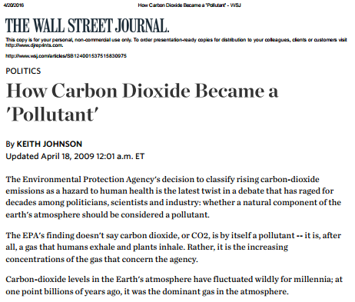
EPA 2009 “decision”: CO2 is a pollutant
http://www.wsj.com/articles/SB124001537515830975

Slide 39
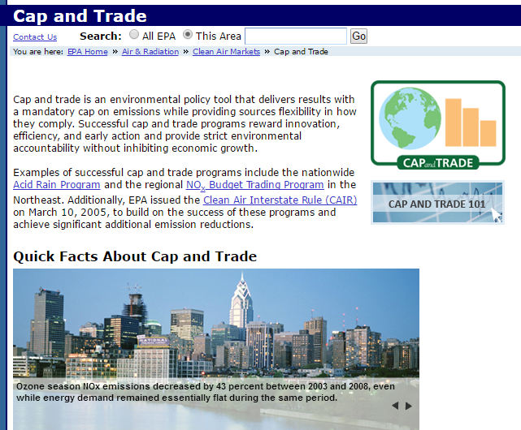

Slide 40
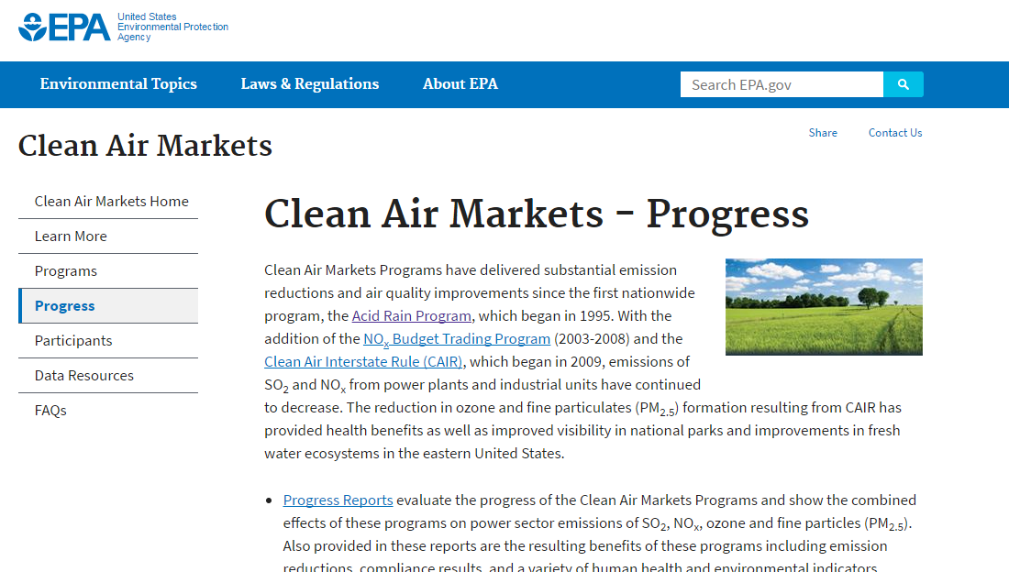
Sulfur dioxide cap and trade program
https://www.epa.gov/airmarkets/clean-air-markets-progress

Slide 41
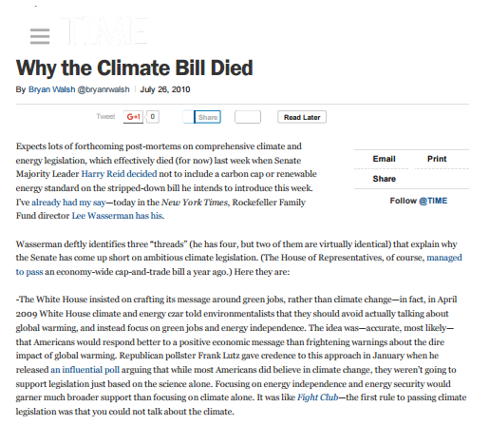
2009 The Waxman- Markey bill would have created a “cap and trade” for CO2
"We worked intensively on it for six months ... seven days a week, long hours. The bill was a top priority for Chairman Waxman," said Barnett, now a consultant, adding, "The entire staff poured their hearts and souls into the effort because they thought it would do something to solve the climate problem as well as create economic opportunities and keep costs low."
http://science.time.com/2010/07/26/why-the-climate-bill-died/

Slide 42
Obama Climate change- State of the Union (1/12/16, 9:31 PM ET)
“We’ve got to accelerate the transition away from dirty energy,” the president said. “That’s why I’m going to push to change the way we manage our oil and coal resources, so that they better reflect the costs they impose on taxpayers and our planet. That way, we put money back into those communities and put tens of thousands of Americans to work building a 21st century transportation system.”

Slide 43
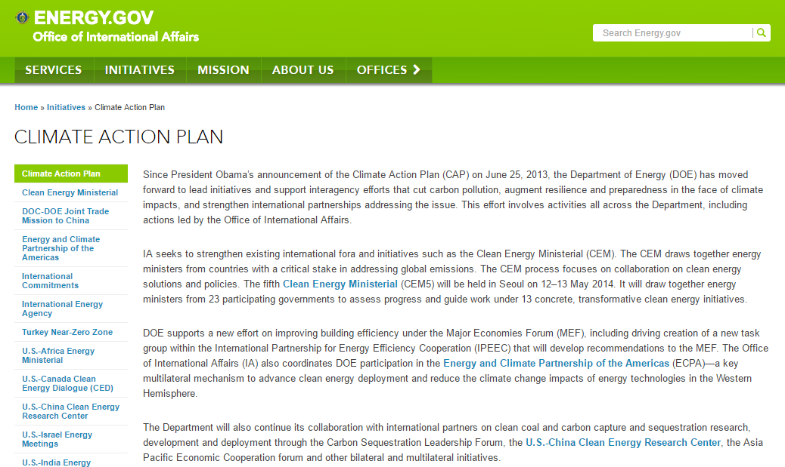
Climate Change Policy first…

Slide 44
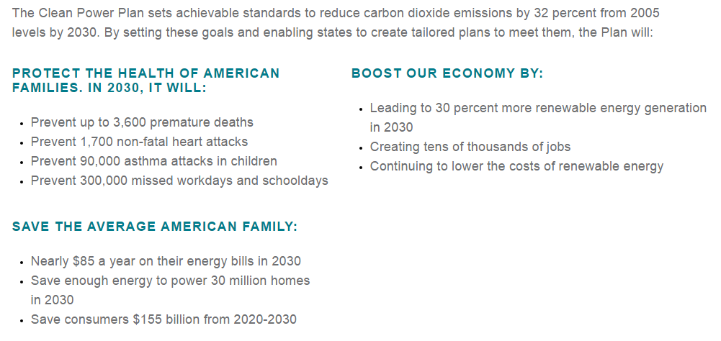

Slide 45
Remedies:
Compensate those harmed directly
Property rights assumption (Coase Theorem)
Lawsuits
Pollution Standards (Command-and-Control)
Tax Pollution
Examples (Solid waste pay-per-throw policy, turtle harvest tax, water pollution taxes, development impact fees)
Challenge - finding appropriate tax rates
Green labeling

Slide 46
“What is the Social Cost of Carbon?”
“Starting with the easiest part first, according to the U.S. Environmental Protection Agency the SCC is “an estimate of the economic damages associated with a small increase in carbon dioxide (CO2) emissions, conventionally one metric ton, in a given year. This dollar figure also represents the value of damages avoided for a small emission reduction (i.e. the benefit of a CO2 reduction).” In its simplest terms, the SCC is a figure that tries to place a value on the damage done or damage avoided by emitting a discrete amount of carbon dioxide.”
https://www.csis.org/analysis/what-social-cost-carbon
One recent estimate is $31 per metric ton
http://www.pnas.org/content/114/7/1518.full

Slide 47
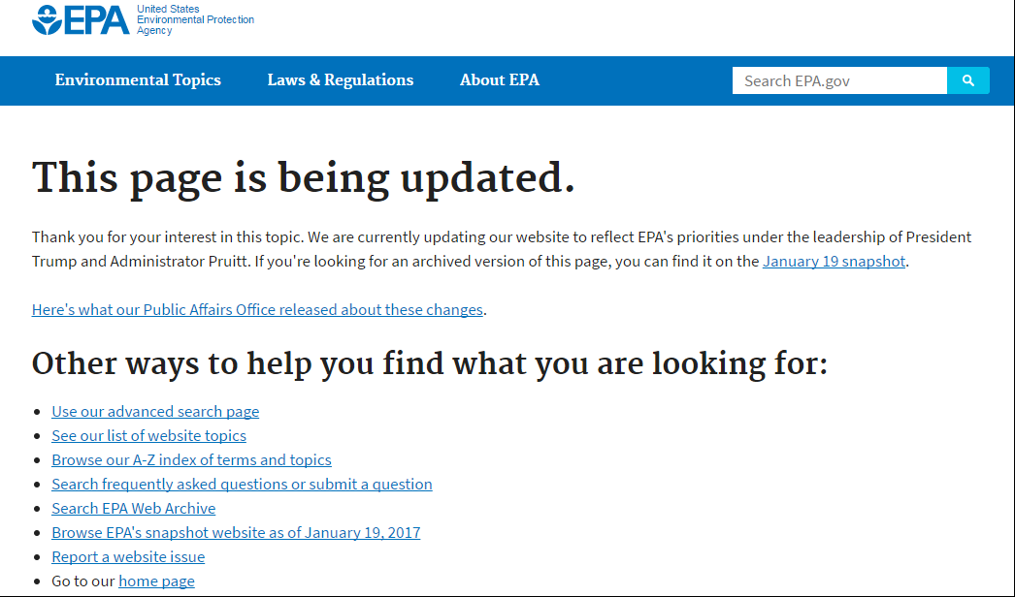
Social Cost of Carbon

Slide 48
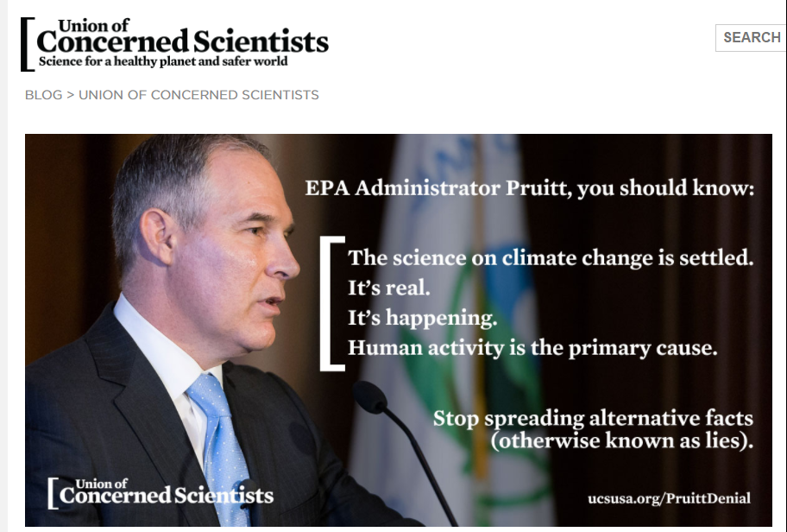
Union of Concerned Scientists Three Facts: http://blog.ucsusa.org/brenda-ekwurzel/epa-head-pruitt-on-climate-change-dead-wrong-three-fundamental-scientific-facts-he-needs-to-know

Slide 49
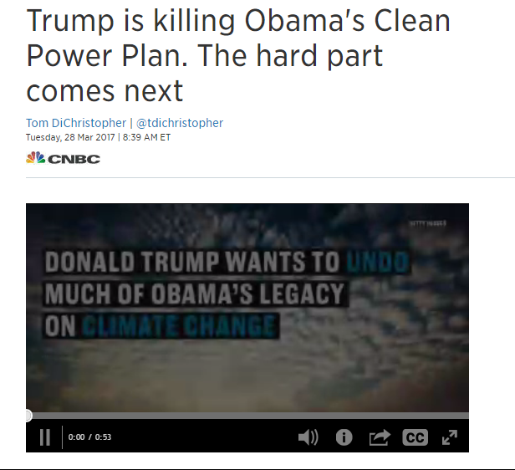
Trump has a different path
http://www.cnbc.com/2017/03/28/trump-is-killing-obamas-clean-power-plan-the-hard-part-comes-next.html

Slide 50
Recent notes
Nearly half of the largest U.S. corporations have set their own targets for emissions reductions, even as the Trump administration retreats from environmental commitments. (WSJ, April27, 2017)
In the U.S., there are more than two jobs in the solar industry for each job in coal (WSJ, April27, 2017)

Slide 51
So lets back track… to Science
Richard Alley
Geology
Milankovitch Cycles

Slide 52
Richard Alley
“Based on the evidence, about 97% of climate experts have concluded that human-caused climate change is happening.”
http://whatweknow.aaas.org/richard-alley/
CO2 and ice cores https://www.youtube.com/watch?v=oHzADl-XID8
https://www.youtube.com/watch?v=ZVn_q4LKDKU
https://www.youtube.com/watch?v=yEUyjDyXCkE

Slide 53
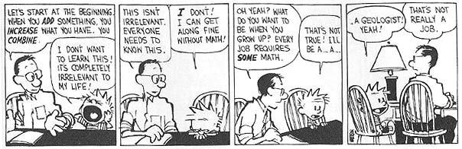

Slide 54
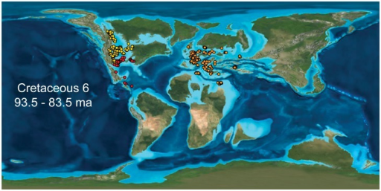
The great Cretaceous Seaway

Slide 55
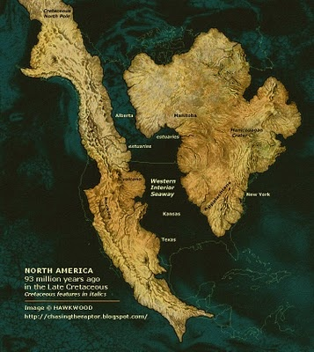
“North America” (93,000,000 years ago)

Slide 56
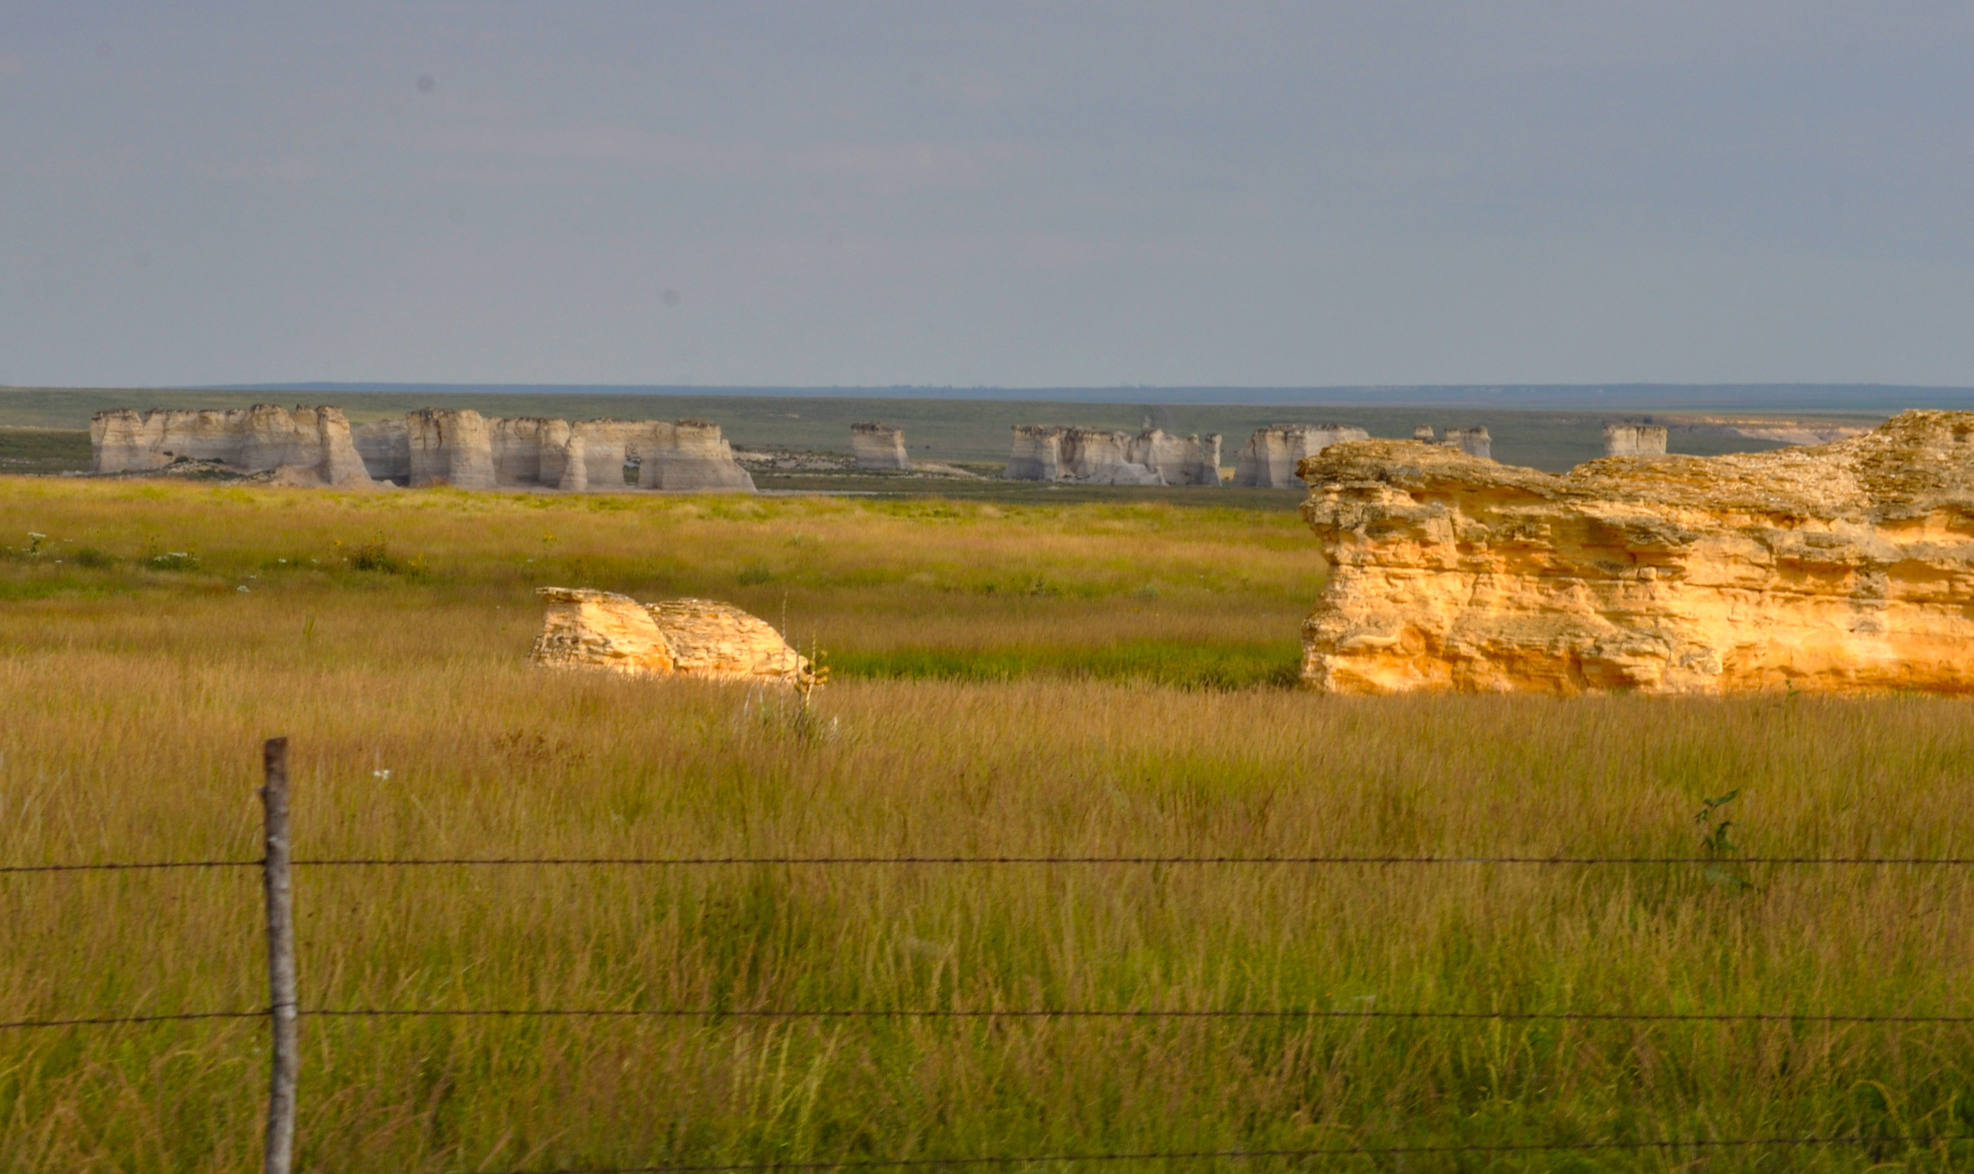
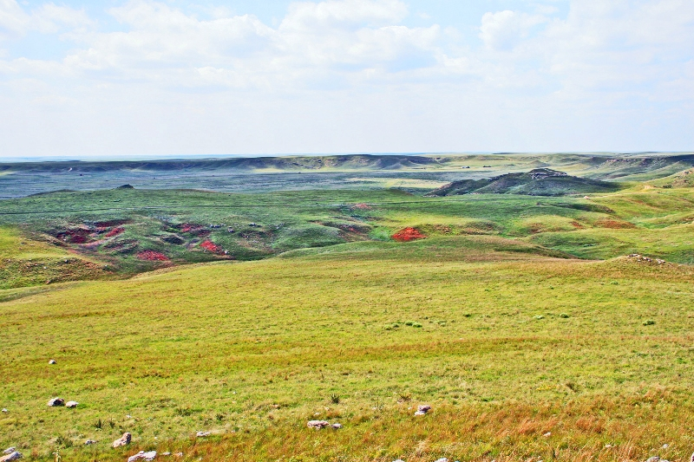

Slide 57
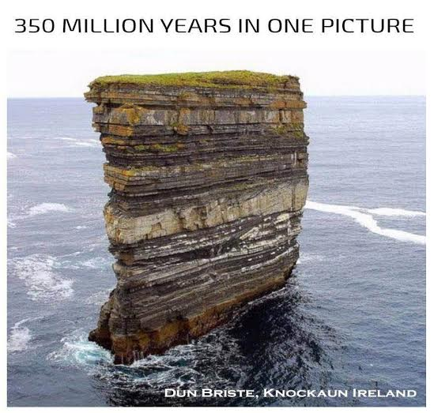
Geology is cool and Calvin’s dad is wrong!

Slide 58
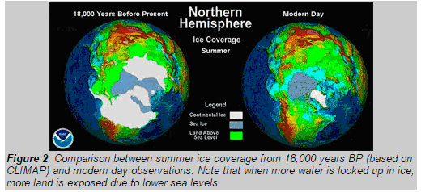

The last glacial maximum (ice age)

Slide 59
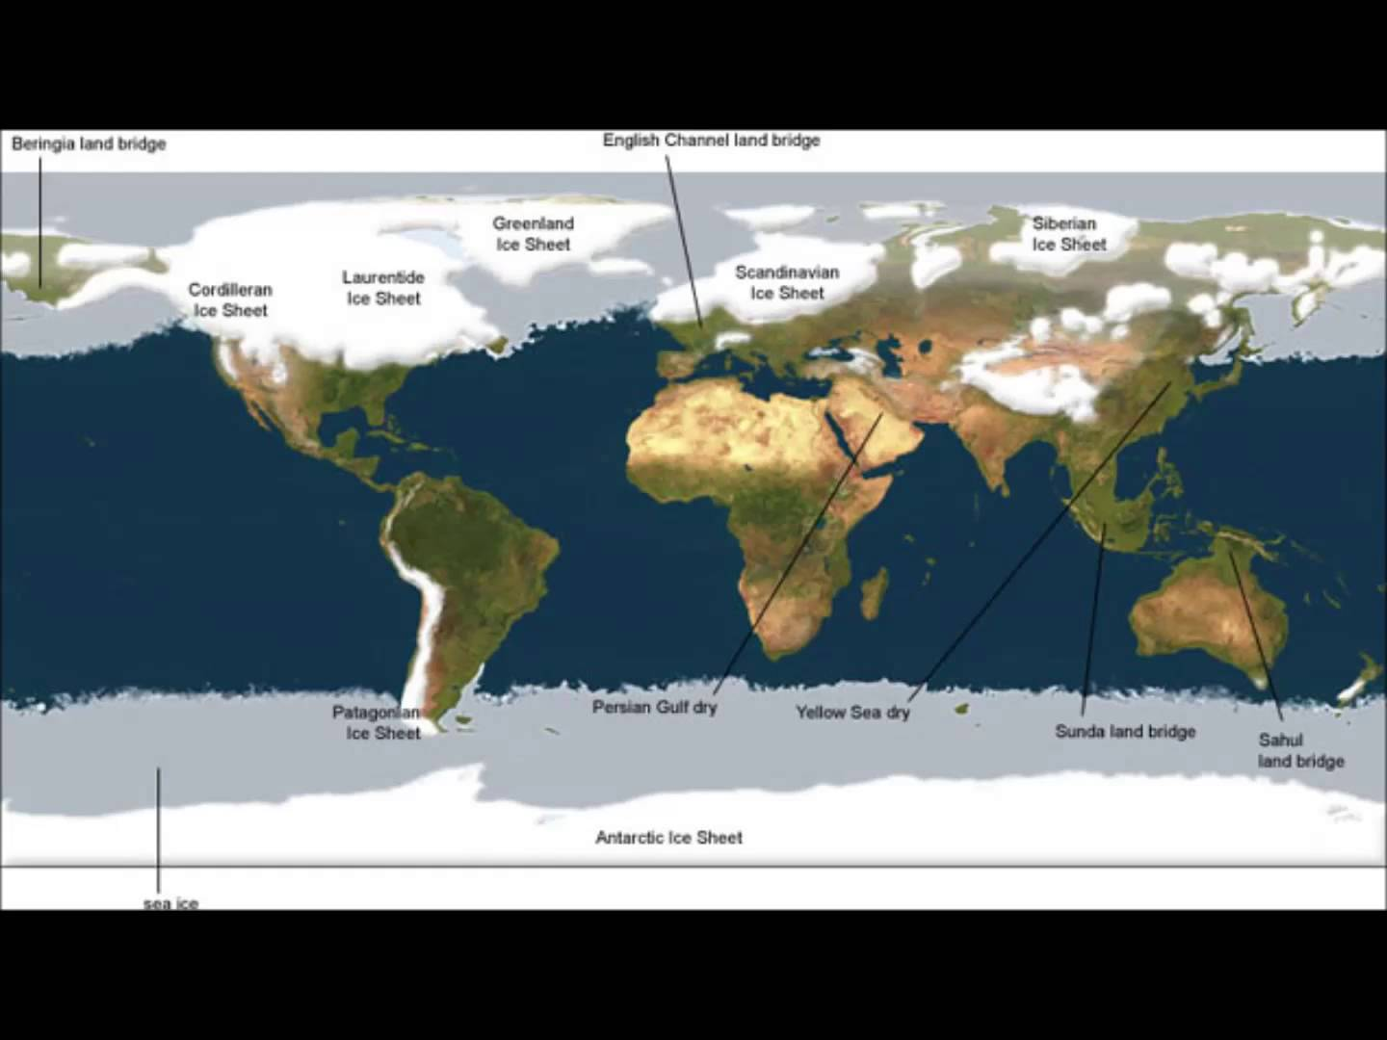
Ice Sheets (18,000 ybp)

Slide 60
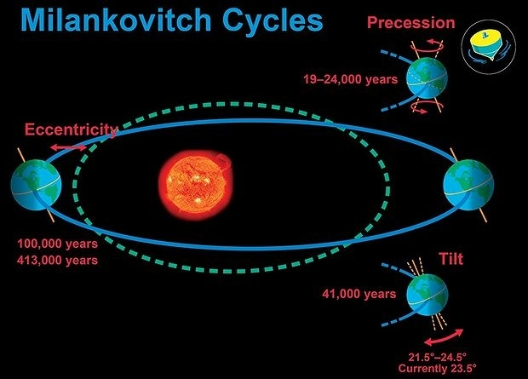
These cycles are attributed to the large scale variations in earth’s climate.

Slide 61
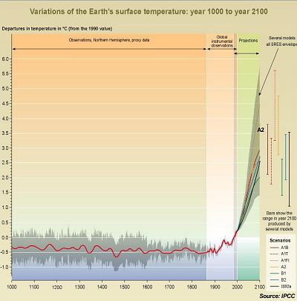
“Hockey Stick” graph (IPCC)

Slide 62
Attitudes
The Pope
Pew research center

Slide 63
Pope Francis Sept 25, 2015
1. Climate change is real, and it’s getting worse.
2. Human beings are a major contributor to climate change.
3. Climate change disproportionately affects the poor.
4. We can and we must make things better.
5. Individuals can help but politicians must lead the charge.

Slide 64
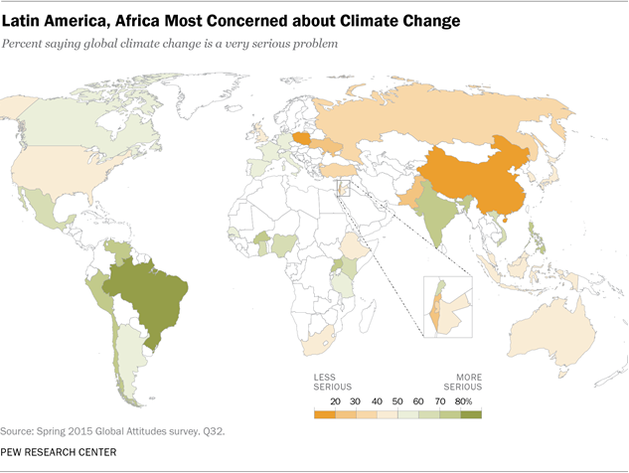
Majorities in all 40 nations polled say climate change is a serious problem, and a global median of 54% believe it is a very serious problem.

Slide 65
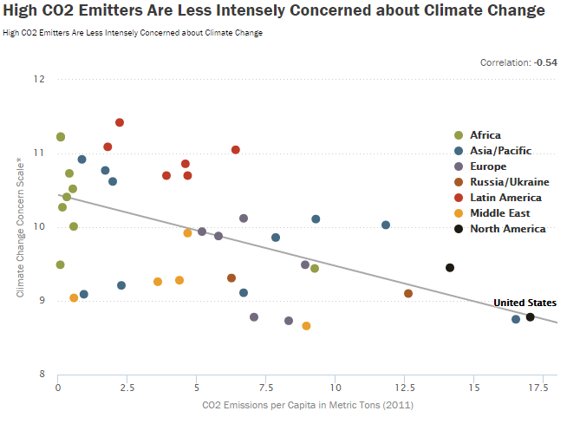
People in countries with high per-capita levels of carbon emissions are less intensely concerned about climate change.

Slide 66
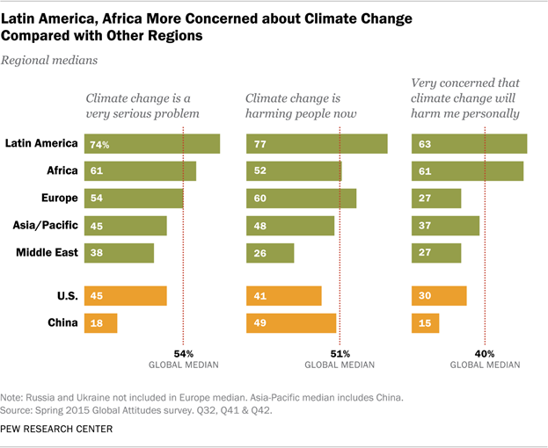
Climate change is not seen as a distant threat. A global median of 51% say climate change is already harming people around the world, while another 28% believe it will do so in the next few years.

Slide 67
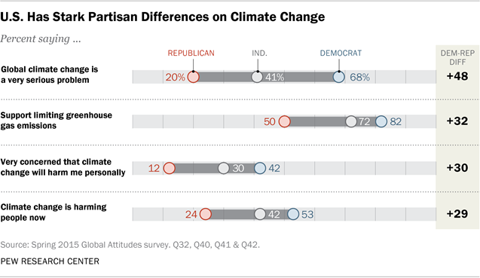
U.S. divided

Slide 68
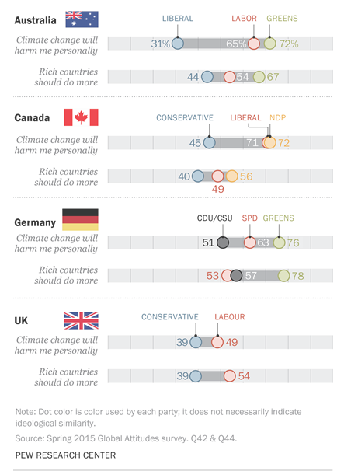
Major Economies

Slide 69
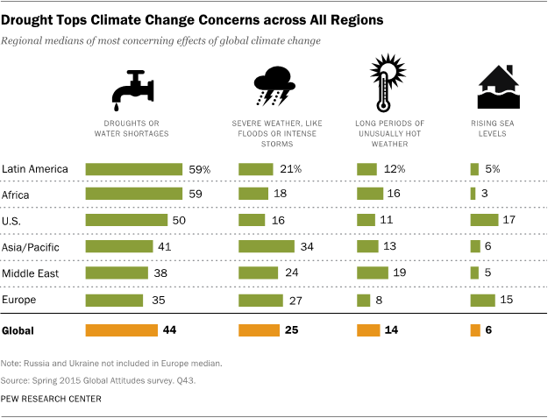
Drought is top concern

Slide 70
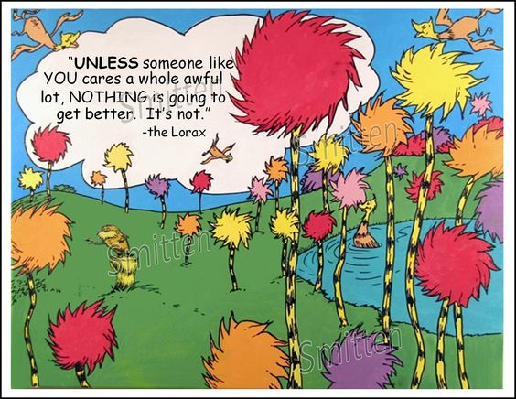
To quote the Lorax…

Slide 71
